Slide 1
Distance-Based Localization
Robot tracking with EKF and optimization

Slide 2
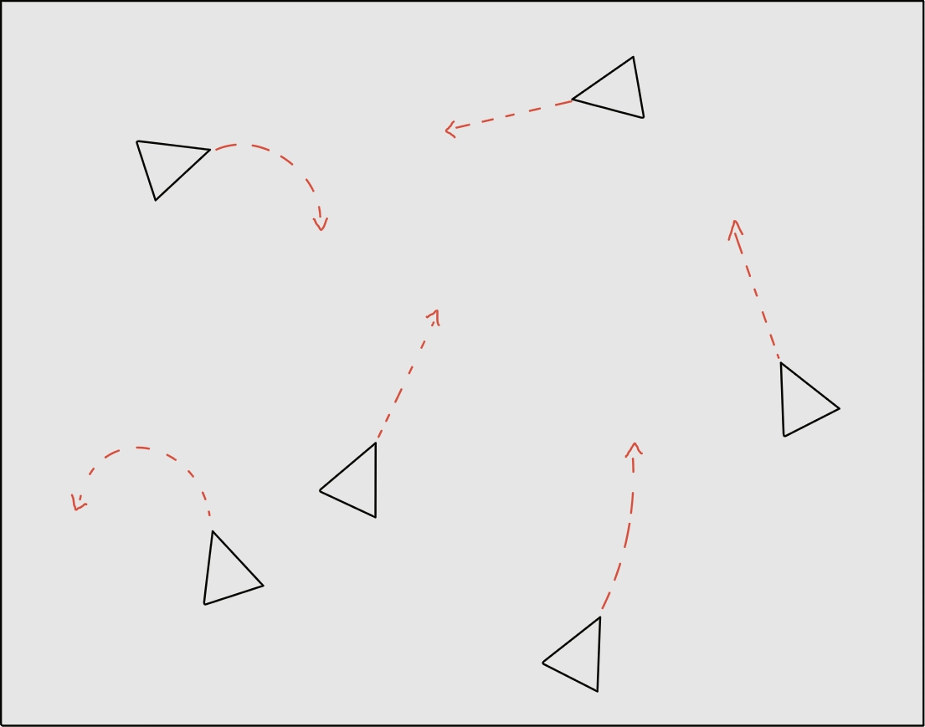
Problem
Notes:
Unicycle Robots (like in class)
Want to track

Slide 3
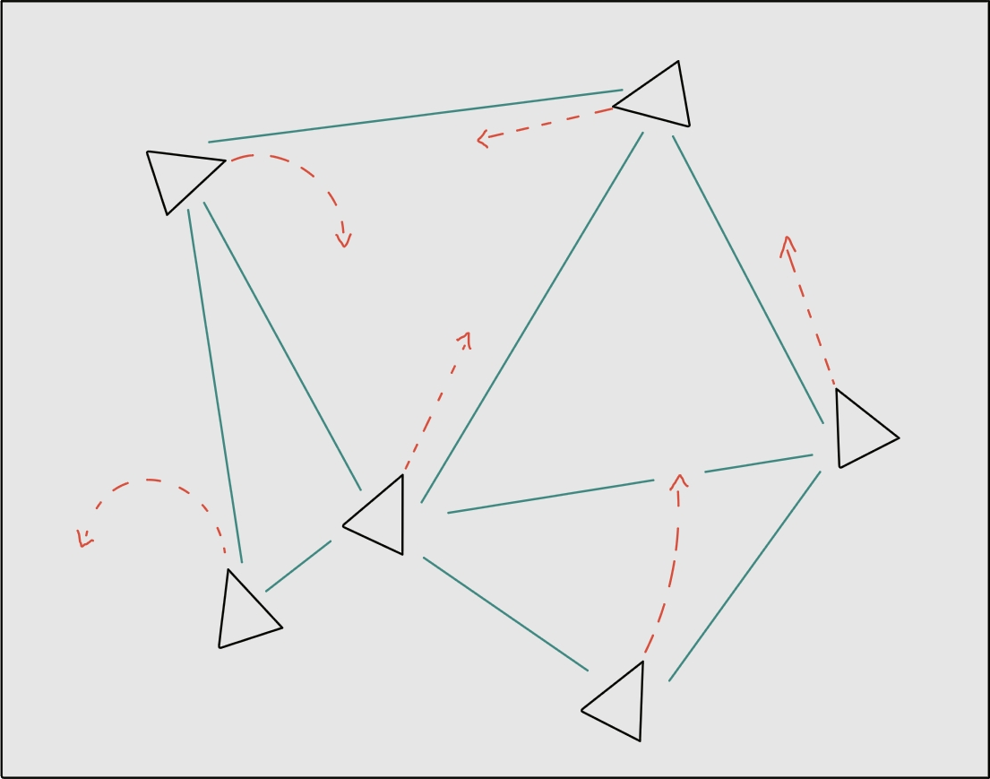
Relative measurements
Notes:
Noisy incomplete relative distance measurements
Can we even do localization? How good can it get?

Slide 4
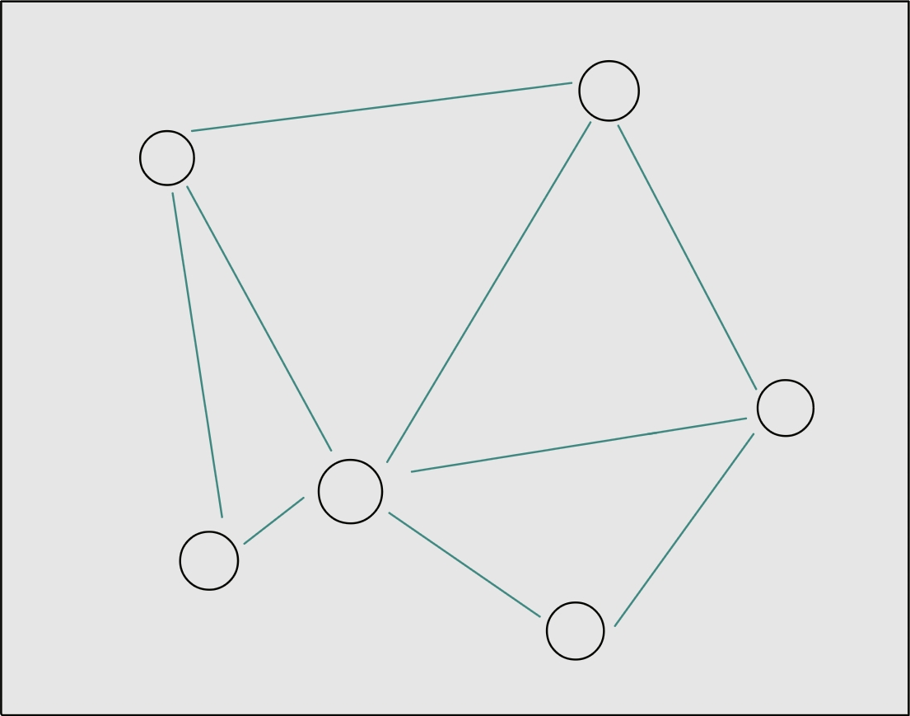
Equivalent formulation
Notes:
This problem is usually formulated as a graph.

Slide 5
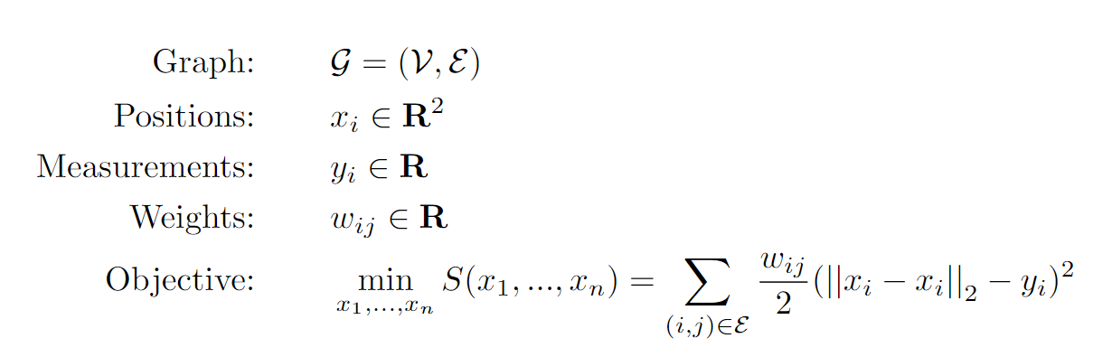
The math
Notes:
Given the graph G want to minimize the stress function. We are minimizing square loss.
Stress function is non-convex and non-differentiable, so this is hard

Slide 6
Problems
Non-differentiable and non-convex
Many local minima
Most algorithms need a good initial guess
Given a good initial guess, many algorithms exist
Notes:
Due to norm not squared, it is not differentiable.
Solvers exist but need good initial guess
For now, assume we know a good initial guess. One algorithm is

Slide 7
Kruskal’s algorithm
Simple
Essentially gradient descent
Smart choice of step sizes
Notes:
Kruskal’s algorithm
Modified gradient descent

Slide 8
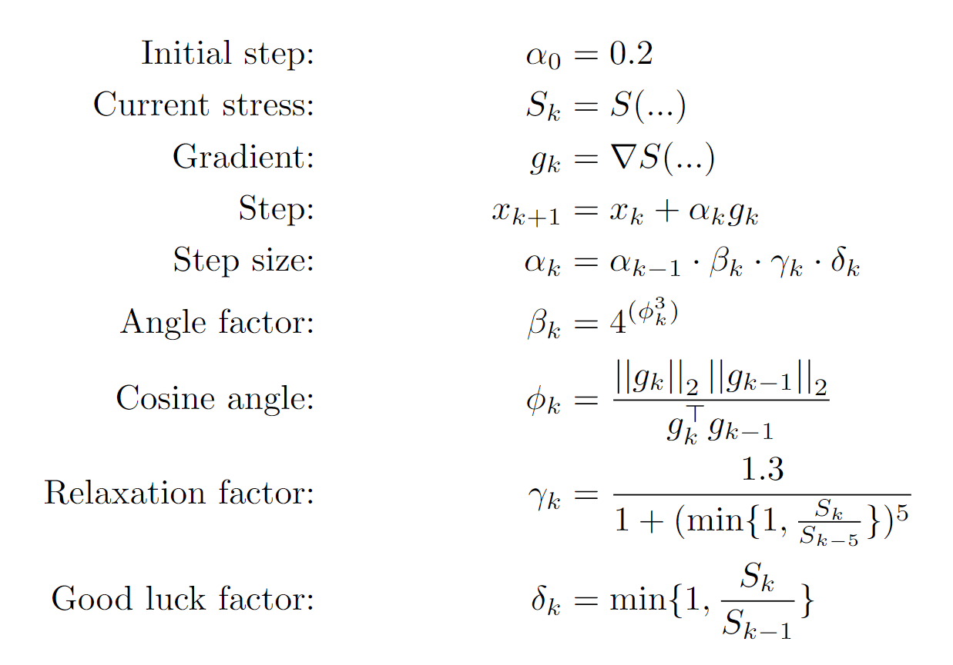
Kruskal’s algorithm
Notes:
I won’t spend much time on this.
Looks complicated, it is simple to implement. Essence of it is, it adapts step size depending on how fast the stress and gradient are changing

Slide 9
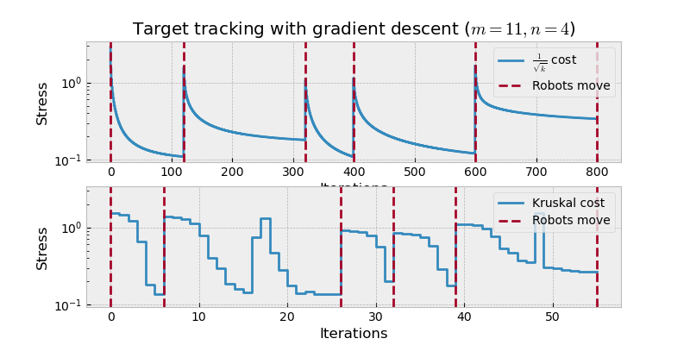
Kruskal’s algorithm
Notes:
4 randomly placed robots, 11 measurements.
Approximate positions of robots are used as a starting point.
We let the algorithms converge then, move robots randomly. Then use old estimate as initial point and reoptimize.
Given good enough initial point, Kruskal converges

Slide 10
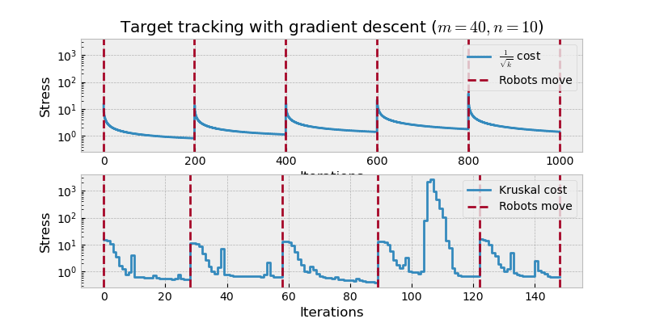
Kruskal’s algorithm
Notes:
Same but 10 robots, 40 measurements

Slide 11
What is this good for?
With good initial guess, the convergence is fast
It is capable of tracking targets that do not move “too far”

Slide 12
Pipeline
Predict
Update
Optimize
Measure
Move
Good initial guess
Notes:
Move robots and measure distances. Then optimize to find positions given prediction as starting point. Update. Repeat.
But what about initial guess?

Slide 13
Riemannian Elevator
Developed at prof. Schwager’s lab
Doesn’t need an initial guess
Solves a higher-dimensional relaxations
Optimizes over edge directions and vertex positions

Slide 14
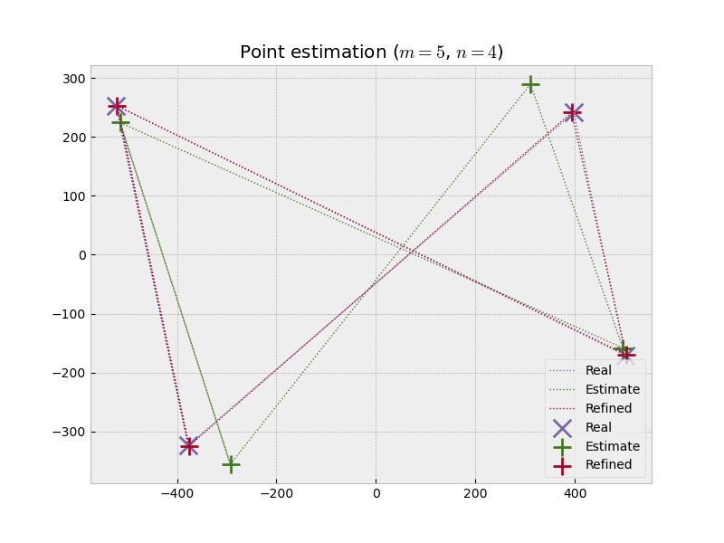
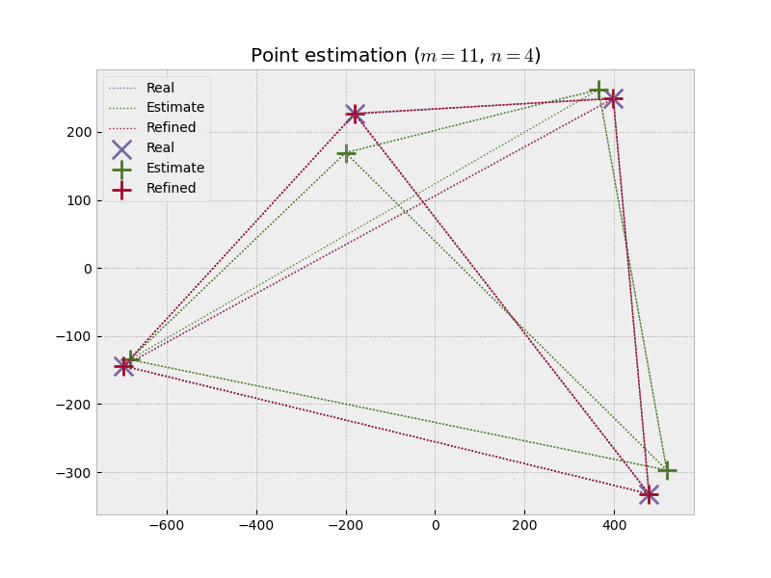
Riemannian Elevator
Notes:
Tends to find a good initial guess that can be quickly optimized further. Red pluses are real positions, green pluses are Riemannian elevator, purple crosses are Kruskal using Riemannian starting point

Slide 15
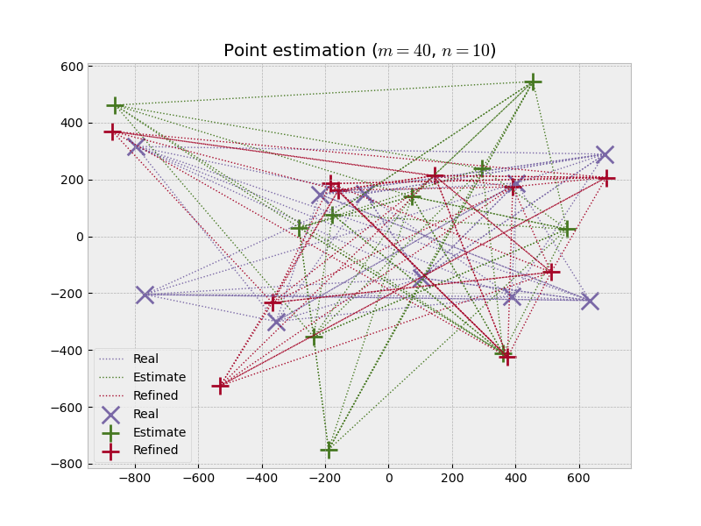
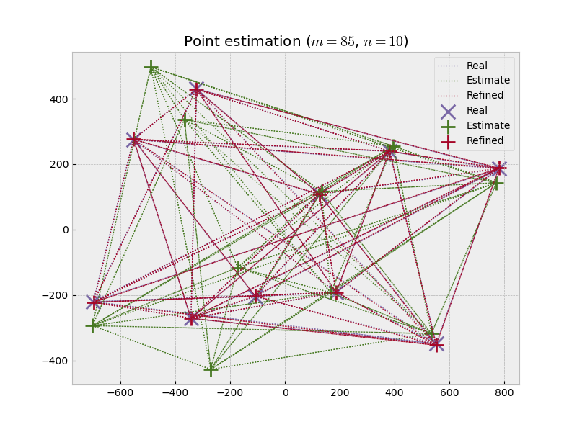
Riemannian Elevator
Notes:
Sometimes can fail for complicated configurations that are not well connected

Slide 16
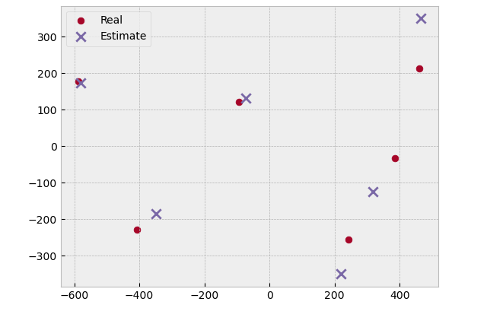

Total pipeline $(m=18, n=6)$
Notes:
50 % connectiveness.
Alright initial guess

Slide 17
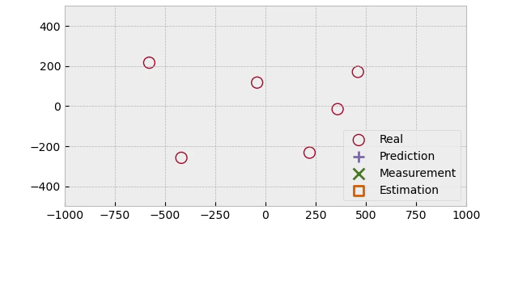
Total pipeline $(m=18, n=6)$
Notes:
Quickly converges to real positions. Can recover from instability

Slide 18
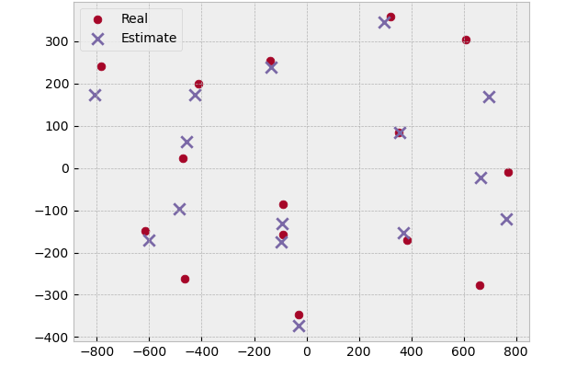

Total pipeline $(m=105, n=15)$
Notes:
Also 50%. Alright initial guess

Slide 19
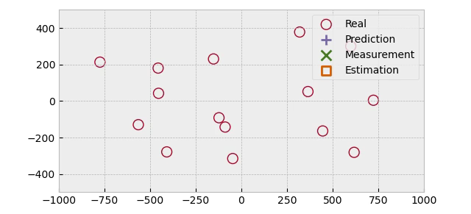
Total pipeline $(m=105, n=15)$
Notes:
At first not great, but then converges

Slide 20
Next steps
Periodic resetting with Riemannian Elevator
Replace Kruskal

